Slide 1
A STAND AGAINST POVERTY AND NEGLIGENCE
CLE 3rd FINAL PERFORMANCE TASK

Slide 2
Christian Living Education
Teacher:
Ms. Liliveth P. Gustilo
Members and Contributions :
Neil Martin Bautista
Ian Angelo Alolod
Zion Zedrick Delfin
Antonio Olpinda
Grade 9A
Prayer
Objective and beneficiaries
Introductory and rationale
Solutions and editor

Slide 3
Objectives
Beneficiaries
Our target is to help those who are poor and are suffering in poverty.
We are to show compassion to those sufferings and misfortunes of others.
To stop the discrimination and issues that are happening in the society.
We're here to do service and spread the teachings of God.
We could spread the teachings of God and make them more faithful to the Lord.
We could gain the trust of others through helping them free from their sufferings.
We could have a stable and peaceful community and society by helping those people who are vulnerable to discrimination.
We could have a good and greater society after solving all of the issues of the society.

Slide 4
01.
INTRODUCTION
“A stand against poverty and negligence”

Slide 5
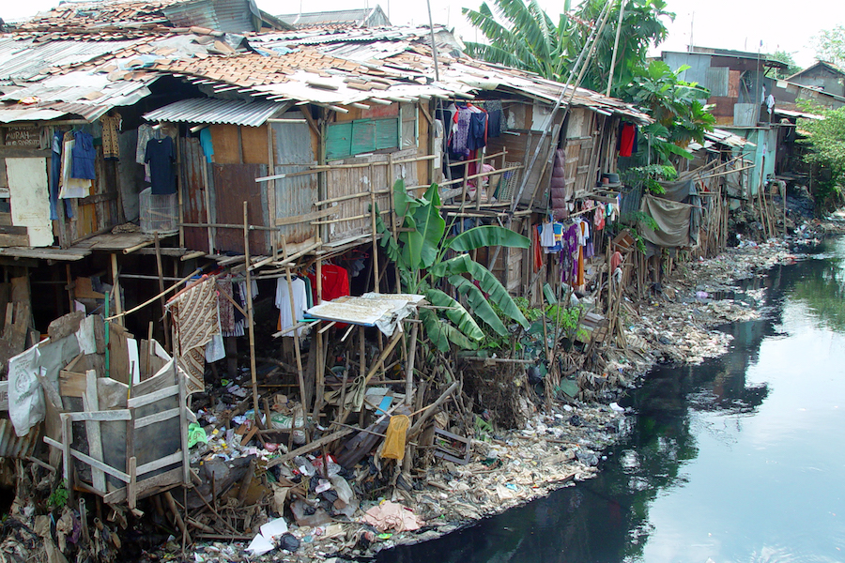
Background of the issue
Poverty has been one of the most controversial issues in our society. And it proves to be one if not, the most difficult issue there is to solve. Poverty leads to the degradation of human life and takes away life opportunities from people. Poverty, in general, is a situation that everyone wants to escape from, but escaping poverty is not easy. If poor families with little to no freedom and opportunities are left alone, they can't climb the social ladder. The poor expect help from others who have a much more stable life. And they desperately need help, for them to survive.

Slide 6
Root causes
Stand of the Church
Now, there are many causes of poverty. Like the lack of education, lack of jobs and livelihood, poor public works, and such. Even climate change and topography can influence a state or an area into a state of poverty. But out of all of these causes, inequality, and marginalization is the deciding factor towards poverty. As sad as it may seem, humans don’t stand on equal grounds, because we are separated by race-ethnicity, community, social status, etc. To put things simply, the privilege and opportunities vary from one person to another. These aspects help create a marginalized community, which is a community, vulnerable to the cycle of poverty.
Many suffered because of poverty and it’s truly a sad fact. But what’s more, heart-wrenching is that discrimination towards the poor exist. And for us, this act of discrimination is evil and we don’t accept this insolence because the Church also condemns the idea of discrimination towards the poor. As humans and representatives of God, compassion towards the needy is an obligation. It is so that we can show our love towards other people as well as our love towards the Lord. Families that are blessed with a much more stable life should show willingness in sharing their wealth and treasures with those in need.
“Those who oppresses the poor show contempt to their Maker, but those who are kind to the needy honour Him.” – Prov. 14:31

Slide 7
02.
Rationale
“A stand against poverty and negligence”

Slide 8
Rationale
Because these issues are prominent in our society, we believe that this project proposal will prove to be significant since its main focus is to stop the discrimination towards the poor and to halt the advancements of poverty in society. We strongly believe that this project proposal can help deter instances of discrimination towards the poor. As a group, we intend to address both the poverty issue and the negligence towards helping the poor. Our aim is to spread awareness about poverty and help by proposing possible solutions to counter said issues.
Even if it’s hard, we will do this for the sake of the community, especially in helping those who suffer from poverty. As we believe that this project proposal will encourage the whole community to unite in order to fight poverty. We want to emphasize the problem of discrimination and encourage others to put a stop to this unlawful and immoral act. We want to teach others that compassion and the willingness to serve and help others is an admirable traits that we as a society should encourage in order to develop a community that follows the teachings of God. And we want to let you know that you can help stop poverty by doing your part. In doing so, you can either follow the solutions that we proposed or do things your own way.

Slide 9
03.
Solutions
“A stand against poverty and negligence”

Slide 10
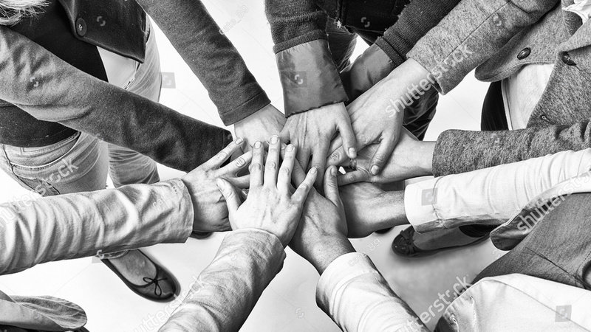
Ⅰ. solutions
Equality and representation for all
Marginalization — the institutional impediments that leave groups of people without representation in their communities — is one of the key causes of extreme poverty. All groups must be involved in the decision-making process in order for a town or country to work its way out of poverty — especially when it comes to having a say in the things that determine your status in society.

Slide 11
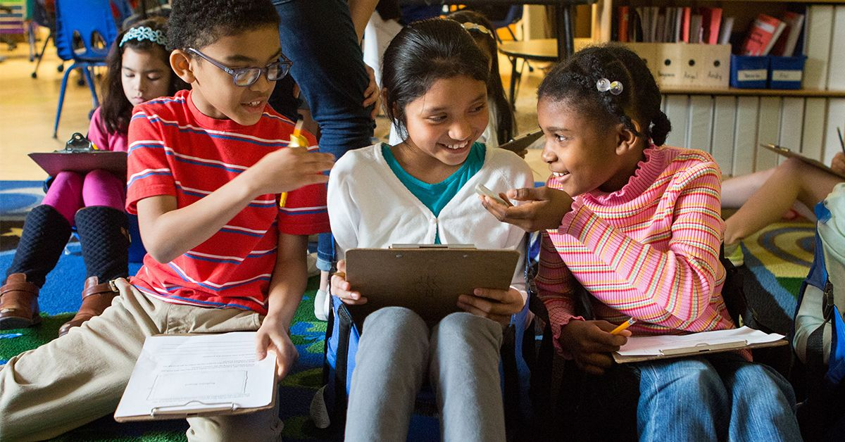
ⅠⅠ. solutions
Increase access to education
According to UNESCO, if all children in low-income nations had only basic reading abilities (and nothing else), an estimated 171 million people would be able to overcome extreme poverty. We could reduce global poverty by more than half if all adults completed secondary education. Education improves skills and talents, reduces risk and vulnerability, and corrects some of the imbalances that result from marginalization.

Slide 12
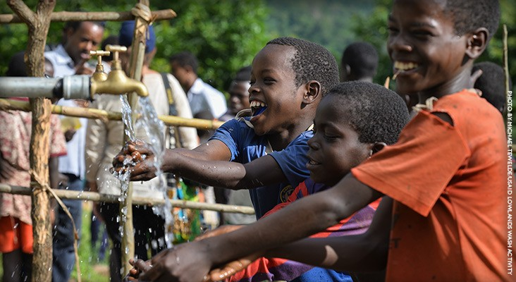
Ⅲ. solutions
Improve food security and access to clean water
Simply eating three meals a day and getting a sufficient number of calories and nutrients will help break the poverty cycle. When a person is malnourished, he or she lacks the strength and energy to work and the ability to finish daily tasks. On the other hand, contaminated water can cause serious health problems and illnesses.

Slide 13
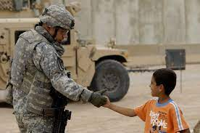
Ⅳ. solutions
End war and conflict
If there is no war, funds set aside to meet the costs of the battle can be used to provide public services. It also lowers the risks encountered by the most disadvantaged communities and ensures that equity and inclusion objectives are met.

Slide 14
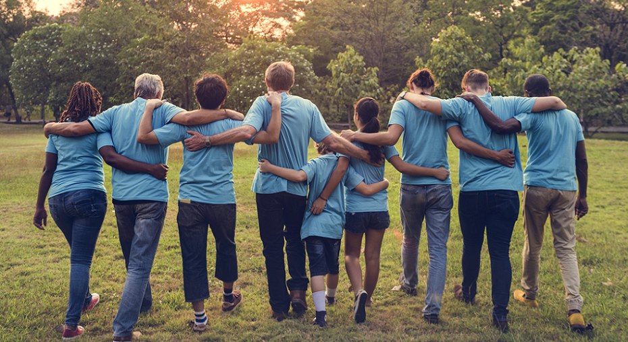
Ⅴ. solutions
Building resilience
Poverty is most likely to occur when there is a high level of marginalization and risk — with risk being its own combination of a person's or group's level of vulnerability and the hazards they face. For instance, The importance of resilience in the face of climate change cannot be overstated. Climate change, according to the World Bank, could push an additional 100 million people into extreme poverty over the next decade if no immediate action is taken.

Slide 15
Prayer
Our Father in Heaven, we kneel down our knees and pray for you. We ask for your blessings that may you bless the poor with help and give them happiness in life. May these blessings brings them joy, happiness, and satisfaction in their life.
Lord God, help those people who are in your deep help, show them the light in their lives that will bring them out to the darkness. Guide them that they will be protected everyday, that they will be taken away from danger. Help them Lord and grant them the grace that will get up for their lives. Reach out those people who has the capability to help, that they will also bless other people with your blessings. May you open their minds that they will be caught to attention to help those poor, let them bring back their blessing that you bring to them. And my these people who are in deep help will have a wonderful today and tomorrow. These all we ask in the mighty name of Jesus our Lord, Amen.

Slide 16
Sources:
Images:
https://www.aeaweb.org/research/world-bank-poverty-line-basic-needs-allen
https://www.change.org/p/all-the-people-together-equal-representation-in-the-parliament-we-women-now-need-the-equality-in-all-aspects
https://learningpolicyinstitute.org/issue/whole-child-education
https://www.usaid.gov/ethiopia/water-and-sanitation
https://origins.osu.edu/article/conflict-termination-how-end-and-not-end-insurgencies?language_content_entity=en
https://www.ohsu.edu/knight-cancer-institute/community-members
Articles:
https://reliefweb.int/report/world/solutions-poverty-get-us-2030

Slide 17
THANK YOU!
A Performance Task collaborations with TLE, CAE, and Mathematics

